Slide 1

App Insights
Workshop
Rainer Stropek
software architects gmbh
Web
Mail
Twitter
http://www.timecockpit.com
rainer@timecockpit.com
@rstropek
Application Performance Management in Azure

Slide 2

Your Host
Rainer Stropek
Developer, Entrepreneur
MVP Microsoft Azure
MVP Development Technologies
MS Regional Director
Senior Consultant IT-Visions
Contact
software architects gmbh rainer@timecockpit.com Twitter: @rstropek

Slide 3
Agenda
Application Insights promises application monitoring as a service without you having to write code for it or setting up servers. Sounds too good to be true? In this session, Rainer Stropek, long-time Azure MVP and MS Regional Director, introduces Application Insights based on a series of live demos. Rainer starts with the basics and works his way up to advanced features like analytics and custom dashboards with Power BI.

Slide 4
App Insights
Time Cockpit

Slide 5
Introduction

Slide 6
What is Application Insights?
Application Performance Management (APM)
PaaS offering provided by Microsoft
Primarily for DevOps teams building web solutions
Data collection, storage, and analytics
Collection done by components provided by Microsoft
Data stored in servers operated by Microsoft
Analytics in Azure Portal, AI Analytics, Power BI, etc.
Ready-made solution
Add AI instrumentation module (e.g. NuGet package)
Add config file or code
No need to write a lot of code or run your own servers

Slide 7
Covered Telemetry
HTTP request rates, response times, success rates
Dependency (HTTP & SQL) call rates, response times, success rates
Exception traces from both server and client
Diagnostic log traces
Usage data like page view counts, user and session counts, etc.
AJAX call rates, response times and success rates
Server performance counters
Custom client and server telemetry

Slide 8
Data Analytics
Alerts
Smart and manual alerts on failure rates and other metrics, and on availability
Charts over time of aggregated metrics
Diagnostic search
Instances of requests, exceptions, custom events, log traces, page views, dependency and AJAX calls
Analytics
Query language over your telemetry
Dashboards will drill-down capabilities
Visual Studio
Code lenses and diagnostic data for debug sessions
Segmentation
By e.g. client location, browser version, OS version, server instance, custom dimensions, and more.

Slide 9
Adding Application Insights
At runtime
No code changes
Available for IIS, Azure Web Apps, Azure Functions, Azure VMs, and J2EE
At development time
Add instrumentation modules and configuration to your code, write custom telemetry
For backend and desktop apps
Native support for .NET, Java, Node.js, JavaScript, Python, Ruby, etc. (details)
Can be integrated in existing logging frameworks like Log4Net, Log4J, LogStash, etc.
Plugins available for commonly used CMS
Availability Tests

Slide 10
AI Intro
Create AI in Azure Portal
Manually
Standard dashboard
Drill down
Chart customization
Search instance data
Application Map

Slide 11
AI Intro
Create web app with AI
Code walkthrough
.NET Core
Full .NET Framework
Visual Studio support
Diagnostic search
Diagnostic tools
Source code integration (exceptions)
AI trends
Code lenses

Slide 12
AI Intro
AI for web pages
Live metrics stream
Build integration
Alerts

Slide 13
Analytics
Search feature of AI
Analytics query language
Details

Slide 14
AI Intro
Analytics

Slide 15
Analytics
requests
| top 10 by timestamp desc
requests
| where resultCode == "500"
| take 10
Requests
| where timestamp > ago(3d)
| top 5 by duration

Slide 16
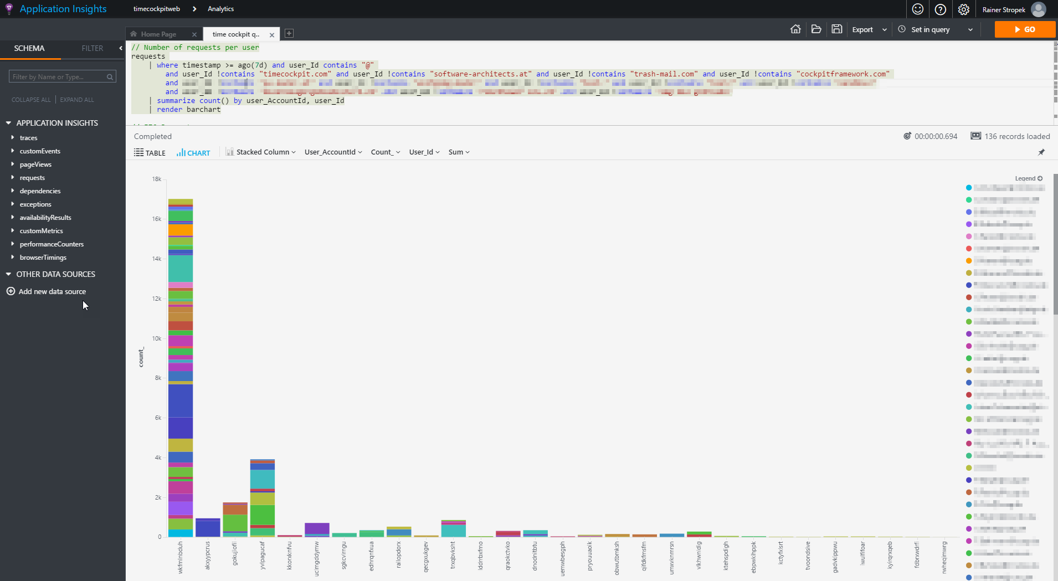
Requests per Tenant

Slide 17
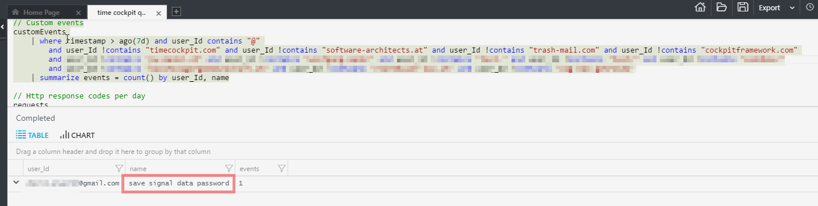
Custom Events

Slide 18
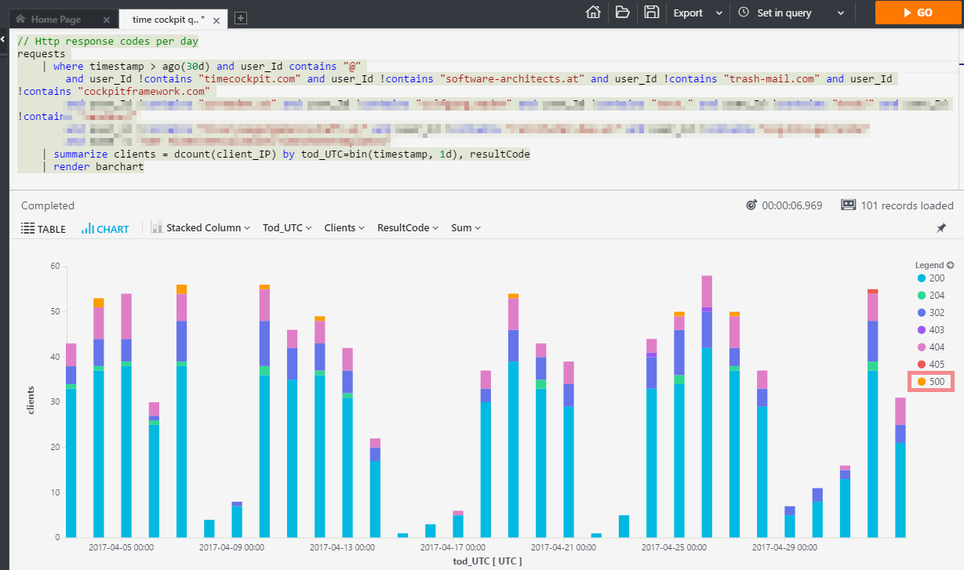
Find Failed Requests

Slide 19
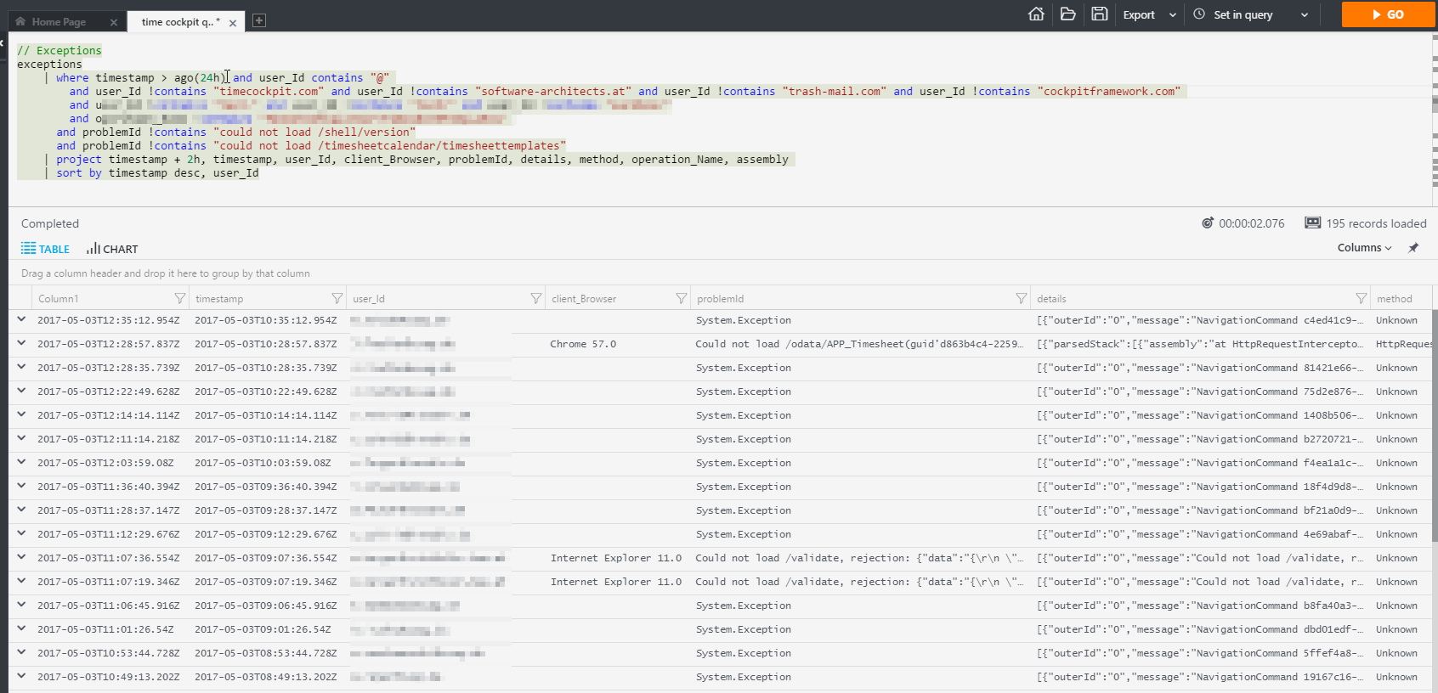
Analyze Exceptions
Client and Server Side

Slide 20
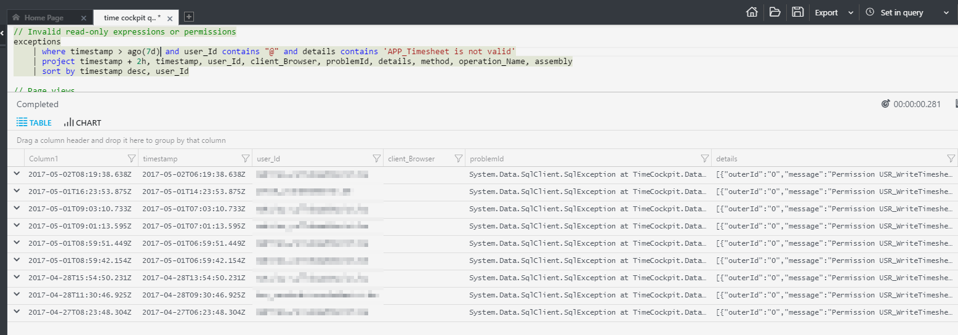
Analyze Specific Failures
Analyze consequences of a breaking change

Slide 21
Q&A
Workshop
Rainer Stropek
software architects gmbh
Web
Mail
Twitter
http://www.timecockpit.com
rainer@timecockpit.com
@rstropek
Thank you for attending!

